Slide 1
Instruction Scheduling

Slide 2
Instruction Scheduling: The Optimization Goal
Given a source program P, schedule the instructions so as to minimize the overall execution time on the functional units in the target machine.

Slide 3
Instruction Scheduling Algorithms

Slide 4
Impact of Control Flow
Acyclic control flow is easier to deal with than cyclic
control flow. Problems in dealing with cyclic flow:
A loop implicitly represent a large run-time program space compactly.
Not possible to open out the loops fully at compile-time.
Loop unrolling provides a partial solution.
more...

Slide 5
Impact of Control Flow (Contd.)
Using the loop to optimize its dynamic behavior is a challenging problem.
Hard to optimize well without detailed knowledge of the range of the iteration.
In practice, profiling can offer limited help in estimating loop bounds.

Slide 6
Acyclic Instruction Scheduling
We will consider the case of acyclic control flow first.
The acyclic case itself has two parts:
The simpler case that we will consider first has no branching and corresponds to basic block of code, eg., loop bodies.
The more complicated case of scheduling programs with acyclic control flow with branching will be considered next.

Slide 7
Instruction Scheduling
Input: A basic block represented as a DAG
i₂ is a load instruction.
Latency of 1 on (i₂,i₄) means that i₄ cannot start for one cycle after i₂ completes.
i₂
0
1
Latency
i₁
i₄
0
0
i₃

Slide 8
Instruction Scheduling (Contd.)
Two schedules for the above DAG with S₂ as the desired sequence.
Idle Cycle Due
to Latency
S₁
i₁
i₃
i₂
i₄
S₂
i₁
i₂
i₃
i₄

Slide 9
The General Instruction Scheduling Problem
Input: DAG representing each basic block where:
1. Nodes encode unit execution time (single cycle) instructions.
2. Each node requires a definite class of FUs.
3. Additional pipeline delays encoded as latencies on the edges.
4. Number of FUs of each type in the target machine.
more...

Slide 10
The General Instruction Scheduling Problem (Contd.)
Feasible Schedule: A specification of a start time for
each instruction such that the following constraints are
obeyed:
1. Resource: Number of instructions of a given type
of any time < corresponding number of FUs.
2. Precedence and Latency: For each predecessor j
of an instruction i in the DAG, i is the started only δ
cycles after j finishes where δ is the latency
labeling the edge (j,i),
Output: A schedule with the minimum overall
completion time (makespan).

Slide 11
Drawing on Deterministic Scheduling
Canonical Algorithm:
1. Assign a Rank (priority) to each instruction (or node).
2. Sort and build a priority list ℒ of the instructions in non-decreasing order of Rank.
Nodes with smaller ranks occur either in this list.

Slide 12
Drawing on Deterministic Scheduling (Contd.)
3. Greedily list-schedule ℒ.
Scan ℒ iteratively and on each scan, choose the largest number of “ready” instructions subject to resource (FU) constraints in list-order.
An instruction is ready provided it has not been chosen earlier and all of its predecessors have been chosen and the appropriate latencies have elapsed.

Slide 13
The Value of Greedy List Scheduling
Example: Consider the DAG shown below:
Using the list ℒ = <i₁, i₂, i₃, i₄, i₅>
Greedy scanning produces the steps of the schedule as follows:
more...

Slide 14
Greedy List Scheduling
On the first scan: i₁ which is the first step.
On the second and third scans and out of the list order, respectively i₄ and i₅ to correspond to steps two and three of the schedule.
On the fourth and fifth scans, i₂ and i₃ respectively scheduled in steps four and five.

Slide 15
Some Intuition
Greediness helps in making sure that idle cycles don’t remain if there are available instructions further “down stream.”
Ranks help prioritize nodes such that choices made early on favor instructions with greater enabling power, so that there is no unforced idle cycle.

Slide 16
How Good is Greedy?
Approximation: For any pipeline depth k ≥ 1 and any number m of pipelines,
1
S_{greedy}/S_{opt} ≤ (2 - ----- ).
mk
For example, with one pipeline (m=1) and the latencies k grow as 2,3,4,…, the approximate schedule is guaranteed to have a completion time no more 66%, 75%, and 80% over the optimal completion time.

Slide 17
This theoretical guarantee shows that greedy scheduling is not bad, but the bounds are worst-case; practical experience tends to be much better.

Slide 18
A Critical Choice: The Rank Function for Prioritizing Nodes

Slide 19
An Example Rank Function
The example DAG
1. Initially label all the nodes by the same value, say α
2. Compute new labels from old starting with nodes at level zero (i4) and working towards higher levels:
(a) All nodes at level zero get a rank of α.
more...
i₂
0
1
Latency
i₁
i₄
0
0
i₃

Slide 20
An Example Rank Function
(b) For a node at level 1, construct a new label
which is the concentration of all its successors
connected by a latency 1 edge.
Edge i₂ to i₄ in this case.
(c) The empty symbol ∅ is associated with latency
zero edges.
Edges i₃ to i₄ for example.

Slide 21
An Example Rank Function
(d) The result is that i₂ and i₃ respectively get new
labels and hence ranks α’= α > α’’ = ∅.
Note that α’= α > α’’ = ∅ i.e., labels are drawn
from a totally ordered alphabet.
(e) Rank of i₁ is the concentration of the ranks of its
immediate successors i₂ and i₃ i.e., it is
α’’’= α’|α’’.
3. The resulting sorted list is (optimum) i₁, i₂, i₃, i₄.

Slide 22
The More General Case Scheduling Acyclic Control Flow Graphs

Slide 23
Significant Jump in Compilation Cost
What is the problem?
Conditional and unconditional branching is permitted.
The problem being optimized is no longer deterministically and completely known at compile-time.

Slide 24
Depending on the sequence of branches taken, the problem structure of the graph being executed can vary
Impractical to optimize all possible combinations of branches and have a schedule for each case, since a sequence of k branches can lead to 2^{k} possibilities -- a combinatorial explosion in cost of compiling.

Slide 25
Containing Compilation Cost
A well known classical approach is to consider traces through the (acyclic) control flow graph. An example is presented in the next slide.

Slide 26
START
BB-3
BB-1
BB-2
BB-4
BB-5
BB-6
A trace BB-1, BB-4, BB-6
BB-7
Branch Instruction
STOP

Slide 27
Traces
“Trace Scheduling: A Technique for Global Microcode
Compaction,” J.A. Fisher, IEEE Transactions on
Computers, Vol. C-30, 1981.
Main Ideas:
Choose a program segment that has no cyclic dependences.
Choose one of the paths out of each branch that is encountered.
more...

Slide 28
Traces (Contd.)
Use statistical knowledge based on (estimated) program behavior to bias the choices to favor the more frequently taken branches.
This information is gained through profiling the program or via static analysis.
The resulting sequence of basic blocks including the branch instructions is referred to as a trace.

Slide 29
Trace Scheduling
High Level Algorithm:
1. Choose a (maximal) segment s of the program with acyclic control flow.
The instructions in s have associated “frequencies” derived via statistical knowledge of the program’s behavior.
2. Construct a trace τ through s:
(a) Start with the instruction in s, say i, with the
highest frequency.
more...

Slide 30
Trace Scheduling (Contd.)
(b) Grow a path out from instruction i in both directions, choosing the path to the instruction with the higher frequency whenever there is
Frequencies can be viewed as a way of prioritizing the path to choose and subsequently optimize.

Slide 31
Trace Scheduling (Contd.)
Rank the instructions in τ using a rank function of choice.
Sort and construct a list ℒ of the instructions using the ranks as priorities.
Greedily list schedule and produce a schedule using the list ℒ as the priority list.

Slide 32
Significant Comments
We pretend as if the trace is always taken and executed and hence schedule it in steps 3-5 using the same framework as for a basic-block.
The important difference is that conditionals branches are there on the path, and moving code past these conditionals can lead to side-effects.

Slide 33
Significant Comments
These side effects are not a problem in the case of basic-blocks since there, every instruction is executed all the time.
This is not true in the present more general case when an outgoing or incoming off-trace branch is taken however infrequently: we will study these issues next.

Slide 34
The Four Elementary but Significant Side-effects
Consider a single instruction moving past a conditional branch:
← Branch Instruction
← Instruction being moved

Slide 35
The First Case
This code movement leads to the instruction executing sometimes when the instruction ought not to have: speculatively.
If A is a DEF Live Off-trace
A
False Dependence Edge Added
Off-trace Path

Slide 36
The First Case (Contd.)
If A is a write of the form a:= …, then, the variable (virtual register) a must not be live on the off-trace path.
In this case, an additional pseudo edge is added from the branch instruction to instruction A to prevent this motion.

Slide 37
The Second Case
Identical to previous case except the pseudo-dependence edge is from A to the join instruction whenever A is a “write” or a def.
A more general solution is to permit the code motion but undo the effect of the speculated definition by adding repair code
An expensive proposition in terms of compilation cost.
Edged added

Slide 38
The Third Case
A
Replicate A
Instruction A will not be executed if the off-trace path is taken.
To avoid mistakes, it is replicated.
Off-trace Path

Slide 39
The Third Case (Contd.)
This is true in the case of read and write instructions.
Replication causes A to be executed independent of the path being taken to preserve the original semantics.
If (non-)liveliness information is available , replication can be done more conservatively.

Slide 40
The Fourth Case
Off-trace Path
Replicate A
A
Similar to Case 3 except for the direction of the replication as shown in the figure above.

Slide 41
At a Conceptual Level: Two Situations
Speculations: Code that is executed “sometimes” when a branch is executed is now executed “always” due to code motion as in Cases 1 and 2.
Legal speculations wherein data-dependences are not violated.
Safe speculation wherein control-dependences on exceptions-causing instructions are not violated.

Slide 42
At a Conceptual Level: Two Situations (Contd.)
Unsafe speculation where there is no restriction and hence exceptions can occur.
This type of speculation is currently playing a role in “production quality” compilers.
Replication: Code that is “always” executed is duplicated as in Cases 3 and 4.

Slide 43
Comparison to Basic Block Scheduling
Instruction scheduler needs to handle speculation and replication.
Otherwise the framework and strategy is identical.

Slide 44
Fisher’s Trace Scheduling Algorithm
Description:
1. Choose a (maximal) region s of the program that has acyclic control flow.
2. Construct a trace τ through s.
3. Add additional dependence edges to the DAG to limit speculative execution.
Note that this is Fisher’s solution.

Slide 45
Fisher’s Trace Scheduling Algorithm (Contd.)
4. Rank the instructions in τ using a rank function of choice.
5. Sort and construct a list ℒ of the instructions using the ranks as priorities.
6. Greedily list schedule and produce a schedule using the list ℒ as the priority list.
7. Add replicated code whenever necessary on all the off-trace paths.

Slide 46
A Detailed Example will be Discussed Now

Slide 47
Example
START
BB1
BB6
BB7
BB2
BB3
BB4
BB5
STOP
BBi
Basic-block

Slide 48
Example (Contd.)
TRACE: BB6, BB2,BB4, BB5
BB6:
BB2:
BB4:
BB5:
6-1
1
6-2
Obvious advantages of global code motion are that the idle cycles have disappeared.
2-2
2-1
1
0
2-4
2-5
0
1
2-3
1
4-1
4-2
Concentration of Local Schedules
5-1
Feasible Schedule: 6-1 X 6-2 2-1 X 2-2 2-3 X 2-4 2-5 4-1 X 4-2 5-1
Global Improvements 6-1 2-2 6-2 2-2 2-3 X 2-4 2-5 4-1 X 4-2 5-1:
6-1 2-1 6-2 2-3 2-2 2-4 2-5 4-1 X 4-2 5-1
6-1 2-1 6-2 2-3 2-2 2-4 2-5 4-1 5-1 4-2
X:Denotes Idle Cycle

Slide 49
Limitations of This Approach
Optimizations depends on the traces being the dominant paths in the program’s control-flow
Therefore, the following two things should be true:
Programs should demonstrate the behavior of being skewed in the branches taken at run-time, for typical mixes of input data.
We should have access to this information at compile time.
Not so easy.

Slide 50
A More Aggressive Solution
“Global Instruction Scheduling for Superscalar
Machines,” D. Berstein and M. Rodeh Proceedings of
the ACM SIGPLAN ‘91 Conference on Programming
Language Design and Implementation, 241-255,
1991.
Schedule an entire acyclic region at once. Innermost regions are scheduled first.
Use the forward control dependence graph to determine the “degree of speculativeness” of instruction movements.
Use generalization of single basic block list scheduling include multiple basic blocks.

Slide 51
Super Block
A trace with a single entry but potentially many exits
Simplifies code motion during scheduling
upward movements past a side entry within a block are pure speculation
downward movements past a side entry within a block are pure replication
Two step formation
Trace picking
Tail duplication - eliminates side entrances

Slide 52
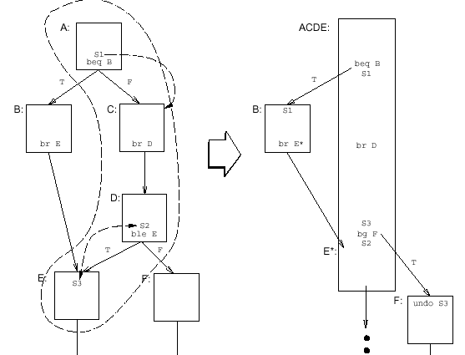
The Problem with Side Entrance
messy book keeping!
side entrance

Slide 53
Exceptions in Speculative Execution
Exception in a speculative instruction ➔ incorrect program behavior
Approach A - only allow speculative code motion on instructions that do not cause exception ➔ too restrictive
Approach B - hardware support ➔ sentinels

Slide 54
Sentinels
Each register contains two additional fields:
exception flag
exception PC
When a speculative instruction causes an exception, the exception flag is set and its current PC is saved
A sentinel is placed in the place where the instructions were moved speculatively
When the sentinel is executed, the exception flag is checked and an exception is taken
A derivation used in IA64 for dynamic runtime memory disambiguation

Slide 55
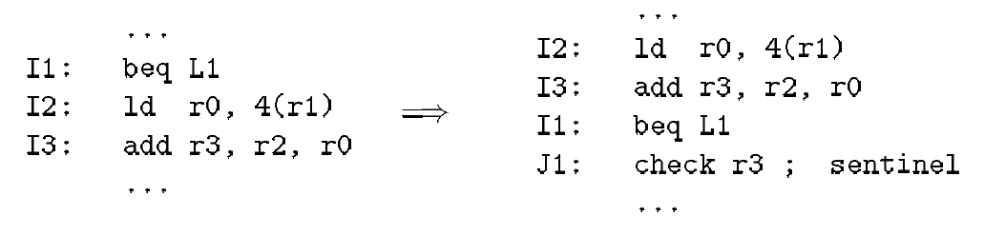
Sentinels - An Example

Slide 56
Super block formation and tail duplication
A
If x=3
If x=3
A
B
y=1
u=v
y=2
u=w
C
y=1
u=v
y=2
u=w
B
C
D
If x=3
D’
D
E
x=y*2
z=y*3
F
E
x=2
F
z=6
E’
G
optimized!
G
G’
H
H

Slide 57
Predicated Execution

Slide 58
Predicated Execution
Found in VLIW/EPIC architectures like HPL-PD (paper design) and Intel IA-64
Also found in ARM
Aim: increase parallelism in presence of branches

Slide 59
Predicated Execution
In HPL-PD and ARM, most operations can be predicated
they can have an extra operand that is a one-bit predicate register.
r2 = ADD.W r1,r3 if p2
if the predicate register contains 0, the operation is not performed
the values of predicate registers are typically set by “compare-to-predicate” operations
p1 = CMPP.<= r4,r5

Slide 60
Uses of Predication
Predication, in its simplest form, is used with
if-conversion
A use of predication is to aid code motion by instruction scheduler.
e.g. hyperblocks
With more complex compare-to-predicate operations, we get
height reduction of control dependences
Kernel Only(KO) code for software pipeline
will be explained in modulo scheduling

Slide 61
If-conversion
If-conversion replaces conditional branches with predicated operations.
Those instructions in branches not taken are disabled by predication.
For example, the code generated for:
if (a < b) c = a; else c = b; if (d < e) f = d; else f = e;
might be the two VLIW instructions:
if (a < b)
c = a
c = b
if (d < e)
f = d
f = e
P1 = CMPP.< a,b
P2 = CMPP.>= a,b
P3 = CMPP.< d,e
P4 = CMPP.>= d,e
c = a if p1
c = b if p2
F = d if p3
F = e if p4

Slide 62
Compare-to-predicate instructions
In previous slide, there were two pairs of almost identical instructions
just computing complement of each other
HPL-PD provides two-output CMPP instructions
p1,p2 = CMPP.UN.UC (r1<r2) if q
p1,p2: destination registers
q : source predicate register
Modifiers:
U means unconditional, N means normal, C means complement
There are other possibilities (conditional, or, and)

Slide 63
If-conversion, revisited
Thus, using two-output CMPP instructions, the code generated for:
might be instead be:
if (a < b) c = a; else c = b; if (d < e) f = d; else f = e;
Only two CMPP operations, occupying less of the VLIW instruction.
p1,p2 = CMPP.W.<.UN.UC a,b
p3,p4 = CMPP.W.<.UN.UC d,e
c = a if p1
c = b if p2
F = d if p3
F = e if p4

Slide 64
Compact Code with Wired- OR/AND predicate operation
HPL-PD has AND/OR modifiers in predicate compare operations which helps to generate more compact code
p1,p2 = CMPP.<m1>.<m2> (r1<r2) if q
<m1>,<m2> : modifiers for conditional, unconditional, wired-or/and predicate operation

Slide 65
Wired-OR/AND Compare-to-Predicate operations
P

Slide 66
Predicted with unconditional operation
p,q := cmpp.un.uc.(y>0)
r,s := cmpp.un.uc.(x=1) if p
t:=cmpp.un.(q∨s)
v := v+1 if r
v := v-1 if t
u := v+y
y > 0
p
q
x = 1
r
s
v:=v+1
v:=v-1
u:=v+y

Slide 67
Predicated with Wired-OR
p,q := cmpp.un.uc.(y>0)
r,q := cmpp.un.oc.(x=1) if p
v := v+1 if r
v := v-1 if q
u := v+y
y > 0
p
x = 1
r
q
v:=v+1
v:=v-1
u:=v+y

Slide 68
The Hyperblock

Slide 69
Hyper block
Single entry/ multiple exit set of predicated basic block (if conversion)
Two conditions for hyperblocks:
Condition 1: There exit no incoming control flow arcs from outside basic blocks to the selected blocks other than the entry block
Condition 2: There exist no nested inner loops inside the selected blocks

Slide 70
Hyper block formation procedure
Tail duplication
remove side entries
Loop Peeling
create bigger region for nested loop
Node Splitting
Eliminate dependencies created by control path merge
large code expansion
After above three transformations, perform if-conversion

Slide 71
A Selection Heuristic
To form hyperblocks, we must consider
execution frequency
size (prefer to get rid of smaller blocks first)
instruction characteristics (eg. hazardous instructions such as procedure calls, unresolvable memory accesses)
A heuristic
“main path” is the most likely executed control path through the region of blocks considered for inclusion in the hyperblock
K is the machine’s issue width
bb_char_{i} is a “characteristic value”; lower for blocks containing harzardous instructions; always less than 1

Slide 72
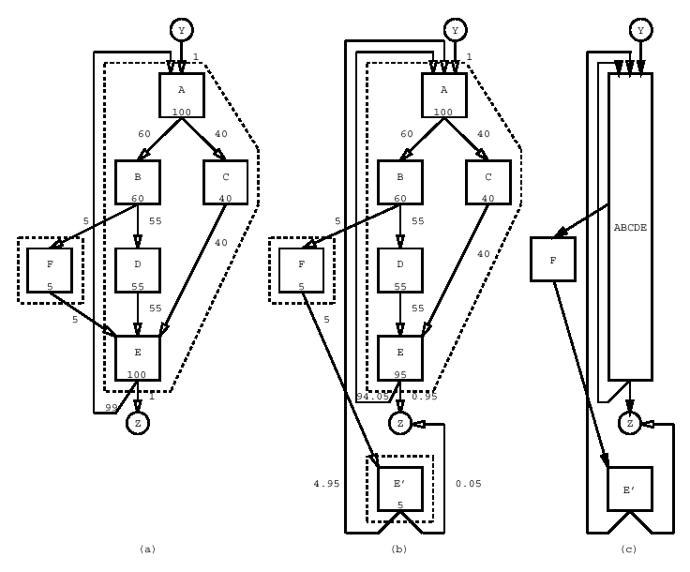
An Example
edge frequency
hyperblock
side entrance
block frequency

Slide 73
Tail Duplication
x > 0
x > 0
y > 0
y > 0
v:=v*x
v:=v*x
x = 1
x = 1
v:=v+1
v:=v-1
v:=v+1
v:=v-1
u:=v+y
u:=v+y
u:=v+y

Slide 74
Loop Peeling
A
A
B
B’
B
C
C’
C
D
D
D’

Slide 75
Node Splitting
x > 0
x > 0
y > 0
y > 0
x = 1
x = 1
v:=v+1
k:=k+1
v:=v-1
v:=v+1
k:=k+1
v:=v-1
v:=v-1
u:=v+y
l=k+z
u:=v+y
l=k+z
u:=v+y
l=k+z
u:=v+y
l=k+z

Slide 76
Node Splitting
At merge points, the execution time of all paths is typically dictated by that of the longest path
Merge completely eliminated by node splitting

Slide 77
Managing Node Splitting
Excessive node splitting can lead to code explosion
Use the following heuristics, the Flow Selection Value, which is computed for each control flow edge in the blocks selected for the hyperblock that contain two or more incoming edges
Weight_flow_{i} is the execution frequency of the edge
Size_flow_{i} is the # of instr. that are executed from the entry block to the point of the flow edge
Large differences in FSV ⇒ unbalance control flow ➔ split those first

Slide 78
Assembly Code
x > 0
A
ble x,0,C
y > 0
B
ble y,0,F
v:=v*x
C
v:=v*x
x = 1
D
ne x,1,F
v:=v+1
E
v:=v+1
F
v:=v-1
v:=v-1
u:=v+y
u:=v+y
G
u:=v+y
u:=v+y

Slide 79
If conversion
A
ble x,0,C
ble x,0,C
d := ?(y>0)
f’:= ?(y<=0)
e := ?(x=1) if d
f”:= ?(x≠1) if d
f := ?(f’∨f”)
v := v+1 if e
v := v-1 if f
u := v+y
B
ble y,0,F
C
v:=v*x
C
v:=v*x
D
ne x,1,F
E
v:=v+1
F
v:=v-1
G
u:=v+y
u:=v+y
u:=v+y

Slide 80
Region Size Control
Experiment shows that 85% of the execution time was contained in regions with fewer than 250 operations, when region size is not limited.
There are some regions formed with more than 10000 operations. (May need limit)
How can I decide the size limit?
Open Issue

Slide 81
Additional references
Region Based Compilation: An Introduction and Motivation, Richard Hank, Wen-mei Hwu, Bob Rau, Micro-28, 1995
Effective compiler support for predicated execution using the hyperblock, Scott Mahlke, David Lin, William Chen, Richard Hank, Roger Bringmann, Micro-25, 1992

Slide 82
Predication in HPL-PD
In HPL-PD, most operations can be predicated
they can have an extra operand that is a one-bit predicate register.
r2 = ADD.W r1,r3 if p2
if the predicate register contains 0, the operation is not performed
the values of predicate registers are typically set by “compare-to-predicate” operations
p1 = CMPP.<= r4,r5

Slide 83
Uses of Predication
Predication, in its simplest form, is used with
if-conversion
A use of predication is to aid code motion by instruction scheduler.
e.g. hyperblocks
With more complex compare-to-predicate operations, we get
height reduction of control dependences
Kernel Only (KO) code for software pipeline
will be explained in modulo scheduling

Slide 84
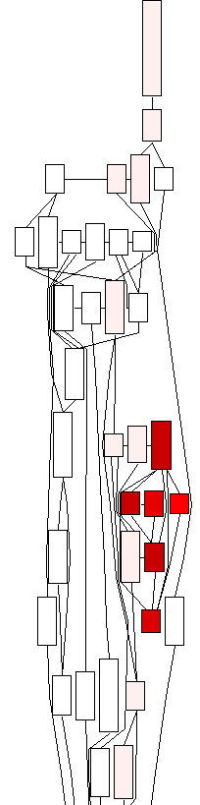
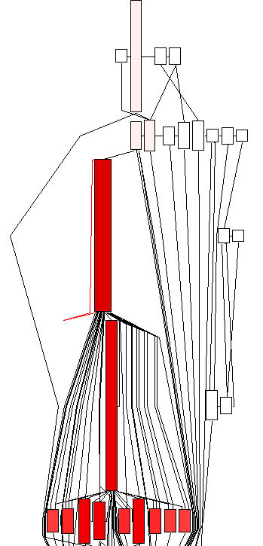
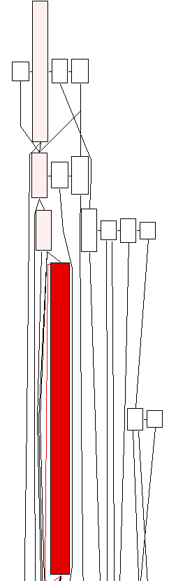
From Trimaran
Basic Block
Super Block
Hyper Block

Slide 85
If-conversion

Slide 86
If-conversion
If-conversion is the process of removing conditional branches by converting control dependencies to data dependences - takes full advantage of predicated execution
It is the final step in hyperblock formation
Performed after
block selection
tail duplication
loop peeling
node splitting

Slide 87
Association with Flow-edges
A predicate register is associated with every conditional flow arc
Basic blocks are if-converted in topological order starting with the entry block which is predicated with the constant TRUE predicate
Two basic blocks can share the same predicate register if they have the same control dependences
BB1 and BB2 have the same control dependences if BB1 dominates BB2 and BB2 post-dominates BB1

Slide 88
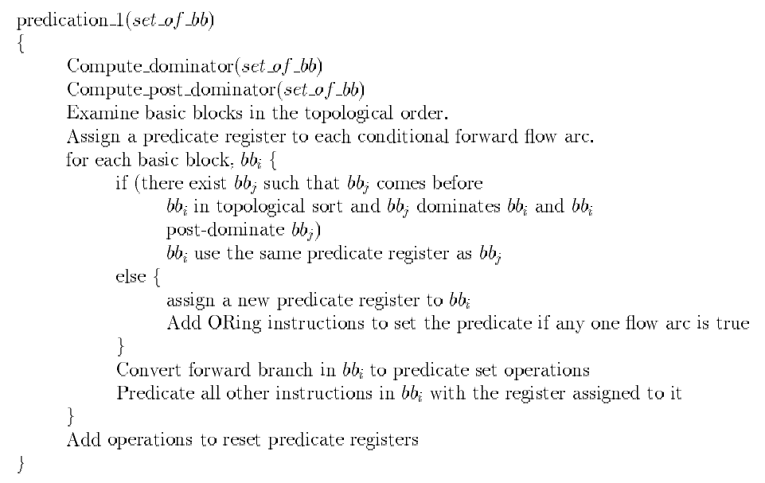
Association with Flow-edges

Slide 89
Example
entry
pr1
pr2
BB1
BB2
pr3
pr4
BB3
BB4
pr5
pr6
pr8
control
equivalent!
BB5
insert OR!
pr7
exit

Slide 90
Second Try
Instead of associating one predicate register per flow edge, associate one per basic block
More efficient than the first - predicate register not used to store conditions at a flow edge

Slide 91
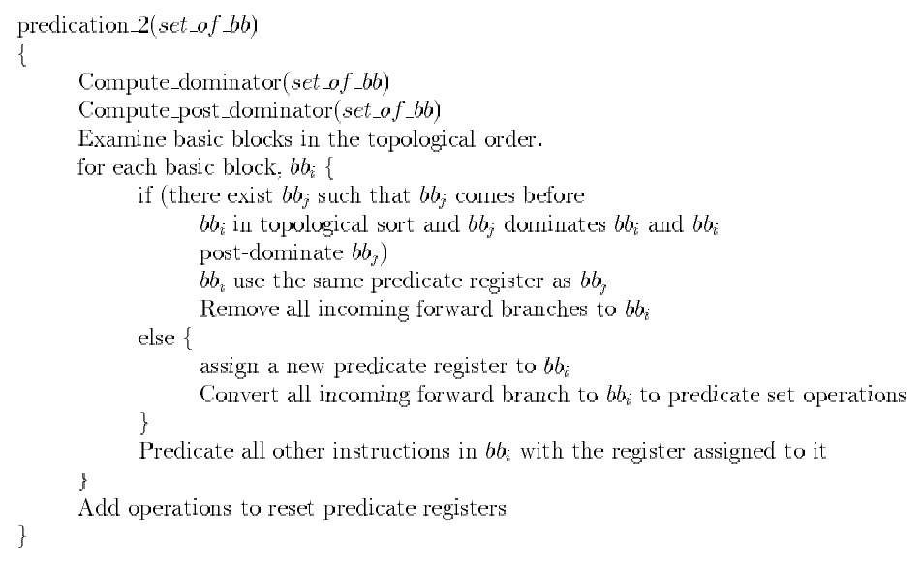
Association with Basic Blocks

Slide 92
The RK Algorithm
The most efficient if-conversion algo - used by IMPACT-Trimaran
R(B) = p
B is a basic block and p is a predicate register
responsible for assignment of predicates
all basic blocks with the same control dependences use the same predicate register
K(p) = S
p is a predicate register and S is a set of branching conditions
responsible for placement of predicate define operations
the earliest edge in a set of basic blocks with the same control dependences
Insert predicate register clear instructions

Slide 93
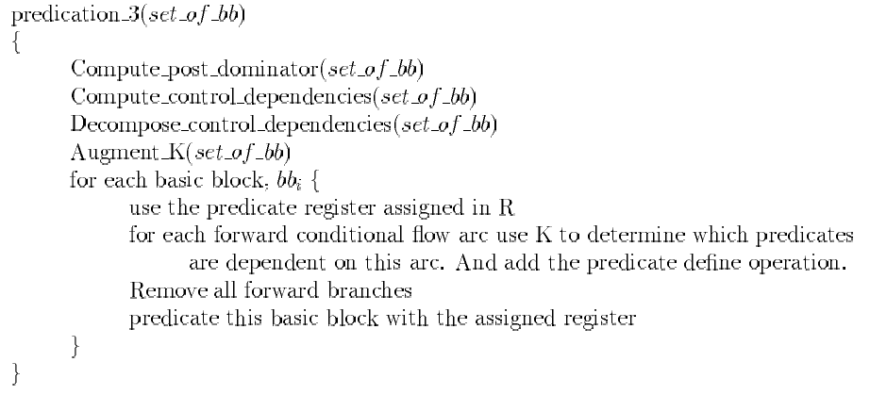
The RK Algorithm
compute R & K
find out where to
clear PR

Slide 94
Example
entry
pr1
pr2 = !pr1
BB1
BB2
pr3
pr4 = !pr3
BB3
BB4
BB5
exit

Slide 95
Another Example
<p0>
A
Block x A B C D E F J D1 D2 D3
R(x) p0 p1 p2 p3 p4 p5 p0 p6 p7 p8
<p1>
B
<p2>
C
<p7>
<p6>
D1
D2
Predicate p p0 p1 p2 p3 p4 p5 p6 p7 p8
K(p) NULL {A} {A} {B} {B, C} {A, C} {B} {C} {C}
<p3>
D
<p4>
E
<p8>
D3
<p5>
F
<p0>
J

Slide 96
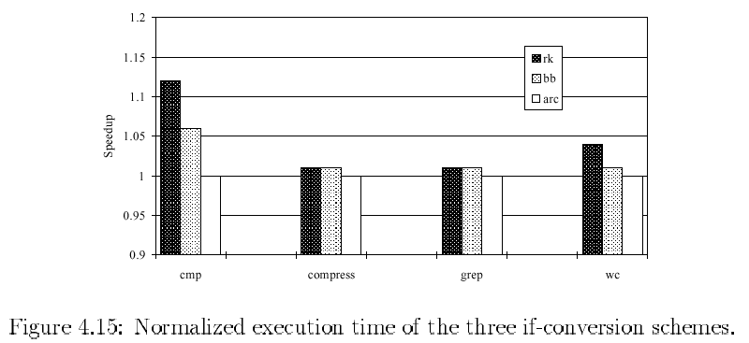
Relative Performance

Slide 97
Scheduling Control Flow Graphs with Loops (Cycles)

Slide 98
Software Pipelining
Software Pipelining is a technique for exploiting parallelism across iterations of a loop.
Iterations are overlayed
Rotating registers support a form of software pipelining called Modulo Scheduling
Rotating registers provide automatic register renaming across iterations

Slide 99
Register Files
Each register file may have a static and a rotating portion
The i^{th} static register in file F is named Fi
The i^{th} rotating register in file F is named F[i]
F [i] ≡ F_{R} [(RRB + i) % size(F_{R})]
F
F_{S}
F_{R}
size(F_{R})

Slide 100
Modulo Scheduling and Rotating Registers
With rotating registers, we can overlay iterations of the loop.
e.g. r[j] in one iteration was r[j-1] in the previous iteration, r[j-2] in the iteration before that, and so on.
thus a single VLIW instruction could conceivably contain an operation from each of the n previous iterations.
where n is the size of the rotating portion of a register file

Slide 101
Main Idea
Loops are treated as integral units.
Conventionally, loop-body is executed sequentially from one iteration to the next.
By compile-time analysis, execution of successive iterations of a loop is overlapped.
Reminiscent of execution in hardware pipelines.

Slide 102
Main Idea (Contd.)
Overall completion time can be much less if there are computational resources in the target machine to support this overlapped execution.
Works with no underlying hardware support such as interlocks etc.

Slide 103
Illustration
Iteration
1
2
n
Conventional Sequential Execution of iterations
Loop Body
n
2
Iterations
Overlapped Execution by
Pipelining iterations
1
Less time overall

Slide 104
Example With Unbounded Resources
A
B
C
D
Four
Independent
Instructions
Loop
Body
SOFTWARE PIPELINE
A
B A
C B A
D C B A
D C B
D C
D
Prologue
New Loop Body
ILP = 4
Epilogue

Slide 105
An Itanium-based Example

Slide 106
Software Pipelining in IA64
A concrete example using the IA64
Register usage in IA64 slightly different from HPL-PD
Integer rotating registers starts from GPR 32
Predicate rotating registers starts from PR 16

Slide 107
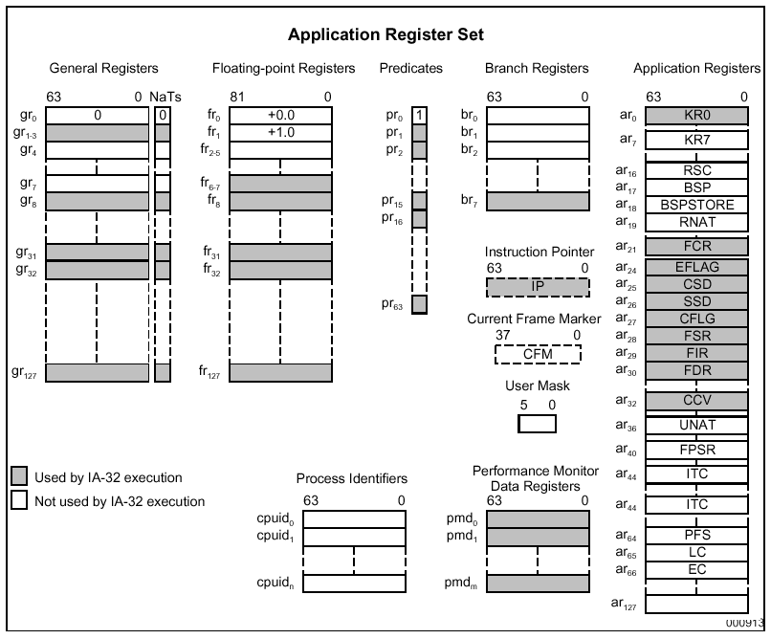
IA64 Registers

Slide 108
The Loop
loop(int N)
{
int i;
for (i=0; i< N; i++)
a[i] += 13;
}

Slide 109
Setting up the counters
addl r14 = @ltoff(a#), gp
;;
ld8 r35 = [r14]
adds r37 = 4, r35
adds r38 = 8, r35
;;
mov pr.rot=0xF<<16
mov.i ar.lc=2
mov.i ar.ec=4
;;

Slide 110
Initialize Rotating Registers
addl r14 = @ltoff(a#), gp
;;
ld8 r35 = [r14]
adds r37 = 4, r35
adds r38 = 8, r35
;;
mov pr.rot=0xF<<16
mov.i ar.lc=2
mov.i ar.ec=4
;;

Slide 111
Setting up loop counter
addl r14 = @ltoff(a#), gp
;;
ld8 r35 = [r14]
adds r37 = 4, r35
adds r38 = 8, r35
;;
mov pr.rot=0xF<<16
mov.i ar.lc=2
mov.i ar.ec=4
;;

Slide 112
Setting up the epilog counter
addl r14 = @ltoff(a#), gp
;;
ld8 r35 = [r14]
adds r37 = 4, r35
adds r38 = 8, r35
;;
mov pr.rot=0xF<<16
mov.i ar.lc=2
mov.i ar.ec=4
;;

Slide 113
The Prolog
ld4 r32=[r35] # 1st iteration
;;
ld4 r34=[r37] # 2nd iteration
adds r32=13,r32
;;
ld4 r33=[r38] # 3nd iteration
adds r34=13,r34
st4 [r35]=r32
;;
adds r36 = 12, r35
mov r37 = r38
adds r38 = 4, r35
;;

Slide 114
The 1st iteration
ld4 r32=[r35] # 1st iteration
;;
ld4 r34=[r37] # 2nd iteration
adds r32=13,r32
;;
ld4 r33=[r38] # 3nd iteration
adds r34=13,r34
st4 [r35]=r32
;;
adds r36 = 12, r35
mov r37 = r38
adds r38 = 4, r35
;;

Slide 115
The Prolog
ld4 r32=[r35] # 1st iteration
;;
ld4 r34=[r37] # 2nd iteration
adds r32=13,r32
;;
ld4 r33=[r38] # 3nd iteration
adds r34=13,r34
st4 [r35]=r32
;;
adds r36 = 12, r35
mov r37 = r38
adds r38 = 4, r35
;;

Slide 116
The Prolog
ld4 r32=[r35] # 1st iteration
;;
ld4 r34=[r37] # 2nd iteration
adds r32=13,r32
;;
ld4 r33=[r38] # 3nd iteration
adds r34=13,r34
st4 [r35]=r32
;;
adds r36 = 12, r35
mov r37 = r38
adds r38 = 4, r35
;;

Slide 117
The Prolog
ld4 r32=[r35] # 1st iteration
;;
ld4 r34=[r37] # 2nd iteration
adds r32=13,r32
;;
ld4 r33=[r38] # 3nd iteration
adds r34=13,r34
st4 [r35]=r32
;;
adds r36 = 12, r35
mov r37 = r38
adds r38 = 4, r35
;;

Slide 118
The Kernel
.L6:
(p16) ld4 r32=[r36]
(p17) adds r33=13,r33
(p18) st4 [r38]=r34
(p19) adds r35=4,r36
br.ctop.dptk.few .L6
;;

Slide 119
The Kernel
During the branch back to the top, the RRB is decremented ➔ R(x) in previous iteration becomes R(x+1) in current iteration
.L6:
(p16) ld4 r32=[r36]
(p17) adds r33=13,r33
(p18) st4 [r38]=r34
(p19) adds r35=4,r36
br.ctop.dptk.few .L6
;;

Slide 120
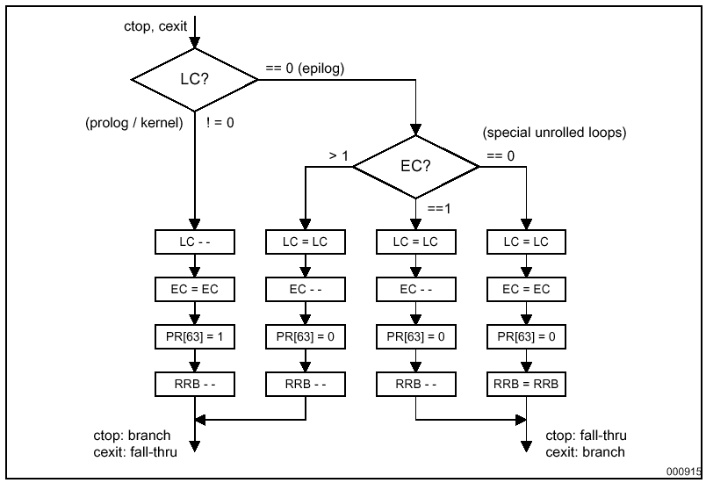
The Counted Loop Branch

Slide 121
Looping the Kernel
LC ≠ 0
.L6:
(p16) ld4 r32=[r36]
(p17) adds r33=13,r33
(p18) st4 [r38]=r34
(p19) adds r35=4,r36
br.ctop.dptk.few .L6
;;
1
1
1
1
p(63) = 1

Slide 122
The Epilog
LC = 0; EC ≠ 0
.L6:
(p16) ld4 r32=[r36]
(p17) adds r33=13,r33
(p18) st4 [r38]=r34
(p19) adds r35=4,r36
br.ctop.dptk.few .L6
;;
0
1
1
1
p(63) = 0

Slide 123
How to do software pipelining

Slide 124
Constraints on The Compiler in Determining Schedule
Since there are no expectations on hardware support
at run-time:
The overlapped execution on each cycle must be possible with the degree of instruction level parallelism in terms of functional-units
The inter-instruction latencies must be obeyed within each iteration but more importantly across iterations as well.
These inter-iteration dependences and consequent latencies are loop-carried dependencies.

Slide 125
Illustration
1
<1,2>
<1,1>
2
3
<1,2>
<0,1>
<0,0>
4
The loop-carry delay <d,p> from an instruction i to another instruction j implies that:
j depends on a value computed by instruction i p iterations ago, and
at least d cycles — denoting pipeline delays — must elapse after the appropriate instance of i has been executed before j can start.

Slide 126
Modulo Scheduling
Find a steady-state schedule for the kernel
The length of this schedule is the initiation interval (II)
The same schedule is executed in every iteration
Primary goal is to minimize the initiation interval
Prologue and epilogue are recovered from the kernel

Slide 127
Minimal Initiation Interval (MII)
delay(c) -- total latency in data dependence cycle c
Σ d
distance(c) -- iteration distance of cycle c
Σ p
uses(r) -- number of occurrence of resource r in one iteration
units(r) -- number of functional units of type r

Slide 128
Minimal Initiation Interval (MII)
Recurrence constrained minimal initiation interval
``Longest cycle is the bottleneck’’
RecMII = max_{c ∈ cycles} delay(c) / distance(c)
Resource constrained minimal initiation interval
``Most critical resource is the bottleneck’’
ResMII = max_{r ∈ resources} uses(r)/units(r)
Minimal initiation interval
MII = max(RecMII, ResMII)

Slide 129
Iterative Modulo Scheduling
Rau 1994
Uses operation list scheduling as building block
Uses some backtracking

Slide 130
Why “Iterative”?
Because II = MII will not always do
Resource conflict
Dependence conflict
Solution:
Start with II = MII, increment II till you get a feasible schedule

Slide 131
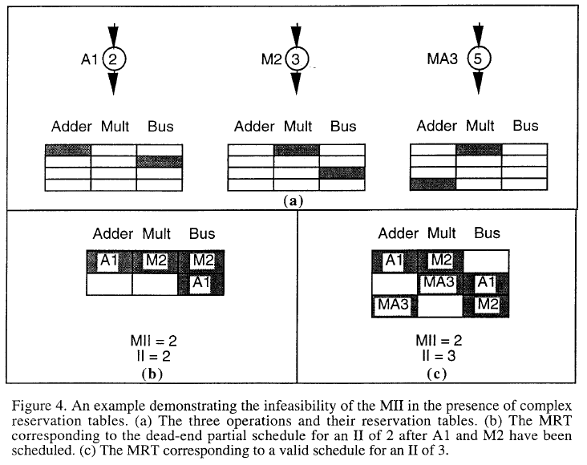
MII Infeasible - resource

Slide 132
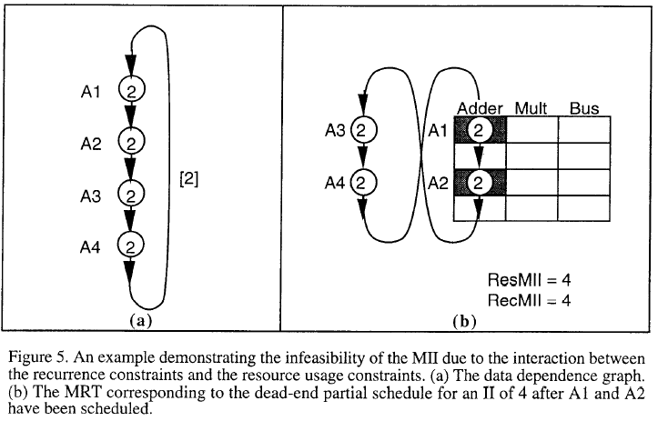
MII Infeasible - dependence

Slide 133
Preprocessing Steps
Loop unrolling
Modulo variable expansion
Loops with internal control flow: remove with if-conversion

Slide 134
Main Driver
budget_ratio is the amount of backtracking to perform before trying a larger II
procedure modulo_schedule(budget_ratio)
compute MII;
II := MII;
budget := budget_ratio * number of operations;
while schedule is not found do
iterative_schedule(II,budget);
II := II + 1;

Slide 135
Iterative Schedule Routine
procedure iterative_schedule(II,budget);
compute height-based priorities;
while there are unscheduled operations and
budget > 0 do
op := the operation with highest priority;
min := earliest start time for op;
max := min + II - 1;
t := find_slot(op,min,max);
schedule op at time t
and unschedule all previously scheduled
instructions that conflict with op;
budget := budget - 1;

Slide 136
Discussion
Instructions are either scheduled or unscheduled
Scheduled instructions may be unscheduled subsequently
Given an instruction j, the earliest start time of j is limited by all its scheduled predecessors k
time(j) >= time(k) + latency(k,j) - II * distance(k,j)
Note that focus is only on data dependence constraints

Slide 137
Find Slot Routine
procedure find_slot(op,min,max);
for t := min to max do
if op has no resource conflict at t
return t;
if op has never been scheduled or
min > previous scheduled time of op
return min;
else
return 1 + previous scheduled time of op;

Slide 138
Discussion of find_slot
Finds the earliest time between min and max such that op can be scheduled without resource conflicts
If no such time slot exists then
if op hasn’t been unscheduled before (and it’s not scheduled now), choose min
if op has been scheduled before, choose the previous scheduled time + 1 or min, whichever is later
Note that the latter choice implies that some instructions will have to be unscheduled

Slide 139
Keeping track of resources
Use modulo reservation table (MRT)
Can also be encoded as finite state automaton
resources
t=0
t=II-1

Slide 140
Computing Priorities
Based on the Critical Path Heuristic
H(i) -- the height-based priority of instruction i
H(i) = 0 if i has no successors
H(i) = max_{k ∈ succ(i)}H(k) + latency(i,k) - II*distance(i,k)

Slide 141
Loop Prolog and Epilog
Consider a graphical view of the overlay of iterations:
Prolog
Kernel
Epilog
Only the shaded part, the loop kernel, involves executing the full width of the VLIW instruction.
The loop prolog and epilog contain only a subset of the instructions.
“ramp up” and “ramp down” of the parallelism.

Slide 142
Prologue of Software Pipelining
The prolog can be generated as code outside the loop by the compiler. The epilog is handled similarly.
b1 = PBRR Loop, 1 s[4] = Mov a . . . s[1] = Mov a+12 r[3] = L s[4] r[2] = L s[3] r[3] = Add r[3],M r[1] = L s[2] Loop: s[0] = Add s[1],4 ; increment i S s[4],r[3] ; store a[i-3] r[2] = Add r[2],M ; a[i-2]= a[i-2]+M r[0] = L s[1] ; load a[i] BRF.B.F.F b1

Slide 143
Removing Prolog/Epilog with Predication
Prolog
Kernel
Epilog
Disabled by predication
Where the loop kernel is executed in every iteration, but with the undesired instructions disabled by predication.
Supported by rotating predicate registers.

Slide 144
Modulo Scheduling with Predication
Notice that you now need N + (s -1) iterations, where s is the length of each original iteration.
“ramp down” requires those s-1 iterations, with an additional step being disabled each time.
The register ESC (epilog stage count) is used to hold this extra count.

Slide 145
Modulo Scheduling with Predication
BRF.B.B.F behaves as follows:
While LC>0, BRF.B.B.F decrements LC and RRB and writes a 1 into P[0] and branches. This for the Prolog and Kernel.
If LC = 0, then while ESC>0, BRF.B.B.F decrements LC and RRB and writes a 0 into P[0] and branches. This is for the Epilog.

Slide 146
Kernel-Only code
S3 if P3
S2 if P2
S1 if P1
S0 if P0
P3
P2
P1
P0

Slide 147
Prologue/Epilogue Generation

Slide 148
Modulo Scheduling with Predication
Here’s the full loop using modulo scheduling, predicated operations, and the ESC register.
s[1] = MOV a LC = MOV N-1 ESC = MOV 4 b1 = PBRR Loop,1 Loop: s[0] = ADD s[1],4 if p[0] S s[4],r[3] if p[3] r[2] = ADD r[2],M if p[2] r[0] = L s[1] if p[0] BRF.B.B.F b1

Slide 149
Algorithms for Software Pipelining
1. “Some Scheduling Techniques and an Easily Schedulable Horizontal Architecture for High Performance Scientific Computing,” B. Rau and C. Glaeser, Proc. Fourteenth Annual Workshop on Microprogramming, 183-198, 1981.
2. “Software Pipelining: An Effective Scheduling Technique for VLIW Machines,” M. Lam, Proc. 1988 ACM SIGPLAN Conference on Programming Languages Design and Implementation, 318-328, 1988.

Slide 150
Cont
``Iterative modulo scheduling: An algorithm for software pipelining loops’’ B. Rau, Proceedings of the 27th Annual Symposium on Microarchitecture, December 1994

Slide 151
Additional Reading:
1. “Perfect Pipelining: A New Loop Parallelization Technique”, A. Aiken and A. Nicolau, Proceedings of the 1988 European Symposium on Programming, Springer Verlag Lecture Notes in Computer Science, No. 300, 1988.
2. “Scheduling and Mapping: Software Pipelining in the Presence of Structural Hazards,” E. Altman, R. Govindarajan and Guang R. Gao, Proc. 1995 ACM SIGPLAN Conference on Programming Languages Design and Implementation, SIGPLAN Notice 30(6), 139-150, 1995.

Slide 152
Additional Reading:
3. “All Shortest Routes from a Fixed Origin in a Graph”, G. Dantzig, W. Blattner and M. Rao, Proceedings of the Conference on Theory of Graphs, 85-90, July 1967.
4. “A New Compilation Technique for Parallelizing Loops with Unpredictable Branches on a VLIW Architecture”, K. Ebcioglu and T. Nakanati, Workshop on Languages and Compilers for Parallel Computing, 1989.

Slide 153
Additional Reading:
5. “ A global resource-constrained parallelization technique”, K. Ebcioglu and Alexandru Nicolau, Proceedings SIGPLAN-89 Conference on Programming Language Design and Implementation, 154-163, 1989.
6. “The Program Dependence Graph and its use in optimization,” J. Ferrante, K.J. Ottenstein and J.D. Warren, ACM TOPLAS, vol. 9, no. 3, 319-349, Jul. 1987.
7. “ The VLIW Machine: A Multiprocessor for Compiling Scientific Code”, J. Fisher, IEEE Computer, vol.7, 45-53, 1984.

Slide 154
Additional Reading:
8. “The Superblock: An Effective Technique for VLIW and Superscalar Compilation”, W. Hwu, S. Mahlke, W. Chen, P. Chang, N. Warter, R. Bringmann, R. Ouellette, R. Hank, T. Kiyohara, G. Habb, J. Holm and D. Lavery, Journal of Supercomputing, 7(1,2), March 1993.
9. “Circular Scheduling: A New Technique to Performing”, S. Jian, Proceedings SIGPLAN-91 Conference on Programming Language Design and Implementatation, 219-228, 1991.

Slide 155
Additional Reading:
10. “Data Flow and Dependence Analysis for Instruction Level Parallelism”, B. Rau, Proceedings of the Fourth Workshop on Language and Compilers for Parallel Computing, August 1991.
11. “Some Scheduling Techniques and an Easily Schedulable Horizontal Architecture for High-Performance Scientific Computing”, B. Rau and C. Glaeser, Proceedings of the 14th Annual Workshop on Microprogramming, 183-198, 1981.

